Slide 1



Life skill
GRADE 2
YEAR 2

Slide 2
OUTLINE
DURATION | CONTENT AREA
Week 1 - 3 | Me and my community (places and people)
Week 4 - 5 | What do I need to live
Week 6 - 7 | Me and other people
Week 8 - 9 | Senses

Slide 3
ASSEESSMENT GOALS
ME AND MY COMMUNITY • Discuss and explain how communities can work together
WHAT DO I NEED TO LIVE • Understand why we have needs to live
ME AND OTHER PEOPLE • Understand and list own role and roles of others • Understand how to deal with conflict in a positive way
SENSES • Explain and discuss how to care for eyes/ears/nose/mouth/skin

Slide 4

WEEK 1 & 2

Slide 5

ME AND MY COMMUNITY

Slide 6
LESSON OBJECTIVES
The learner must be able to:
• Acknowledge that he/she is part of a community
• Identify places in their community like hospital, clinic, police, taxi rank, post office etc.
• Discuss ways how the community can work together to make it a nice place to live in

Slide 7

GROUP 1

Slide 8
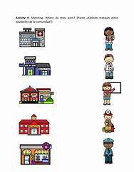
Task 1: Colour the picture below

Slide 9
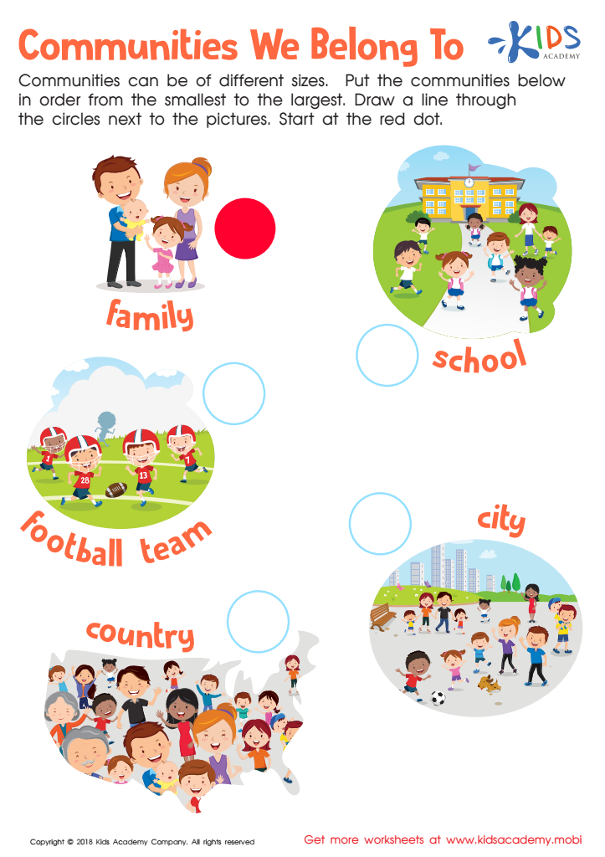

Slide 10
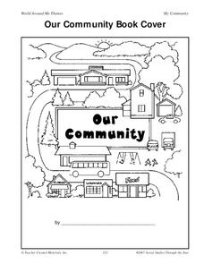
Task 2: Colour in the picture

Slide 11

GROUP 2

Slide 12
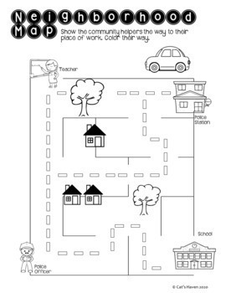
Task 1: Find a way to each destination

Slide 13
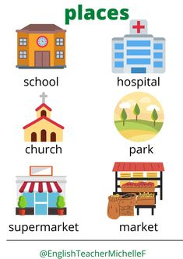
Task 3: Match the following pictures with the correct place and write 1 sentence.

Slide 14
GROUP 3

Slide 15
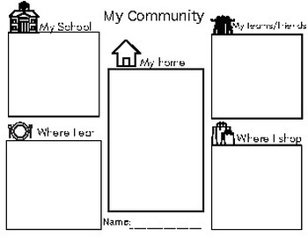
Task 1: Draw pictures of each community

Slide 16
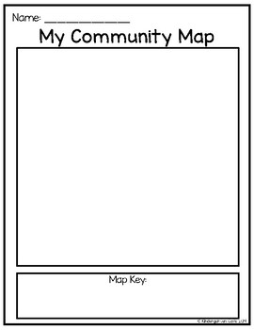
Task 2: Draw your own community map

Slide 17
WEEK 3 & 4 what do l need to live

Slide 18

WHAT DO I NEED TO LIVE

Slide 19
LESSON OBJECTIVES
Recognise that we need the following to live:
• Different types of food
• Water
• Air
• Sunlight (include protection from the sun)
• Shelter
• Friends
• People at school and at home include sharing, helping, showing respect.

Slide 20
GROUP 1

Slide 21
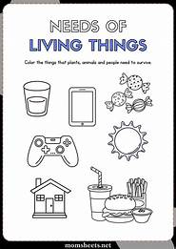
Task 1: Colour only and trace things that we need to live

Slide 22
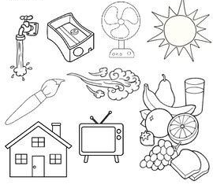
Task 2: Colour all the things that we need to live.

Slide 23
GROUP 2

Slide 24
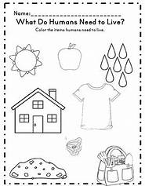
Task 1: what do people need to live? Colour the items that we need to live

Slide 25
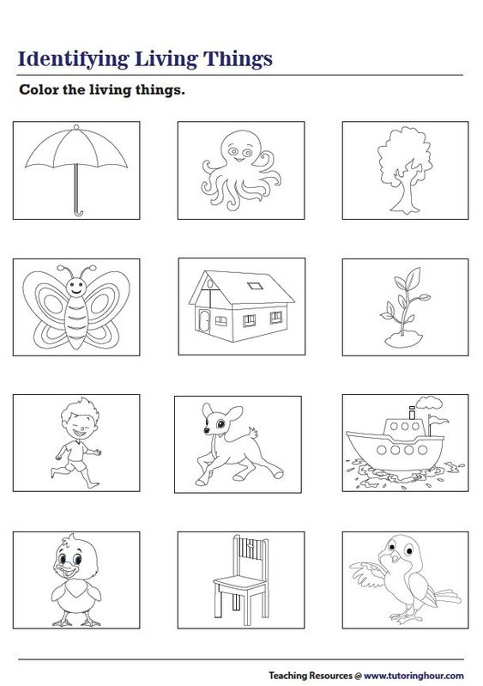
Task 2: Colour the pictures that we need to live.

Slide 26
GROUP 3

Slide 27
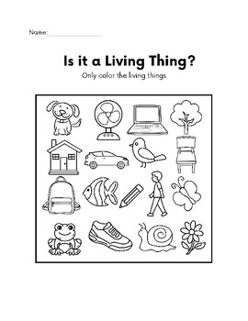
Task 3:Colour only the items we need to live

Slide 28
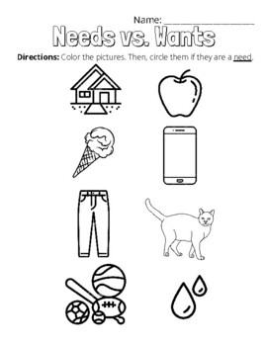
Task 2:Color the items that we need to live

Slide 29
WEEK 6 & 7
ME AND OTHER PEOPLE

Slide 30
LESSON OBJECTIVES
Recognise own role as a child
Recognise roles of other people, at home, at school, in the community and in the environment.
Deal positively with conflict - include self- esteem and bullying.

Slide 31
GROUP 1

Slide 32
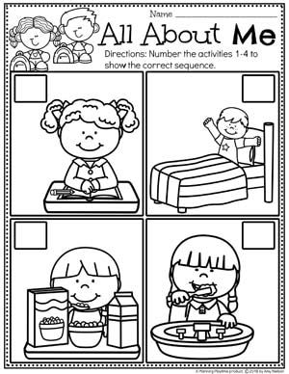
Task 1: Me: Order the picture

Slide 33

Task 1: Gather as a class and sing the song

Slide 34
GROUP 2

Slide 35
Task 1: Design a poster of the differences of you and your friend

Slide 36
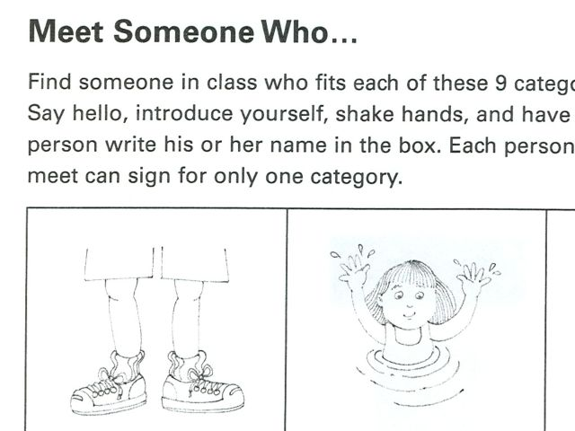
Task 2: Me and other people

Slide 37
GROUP 3

Slide 38
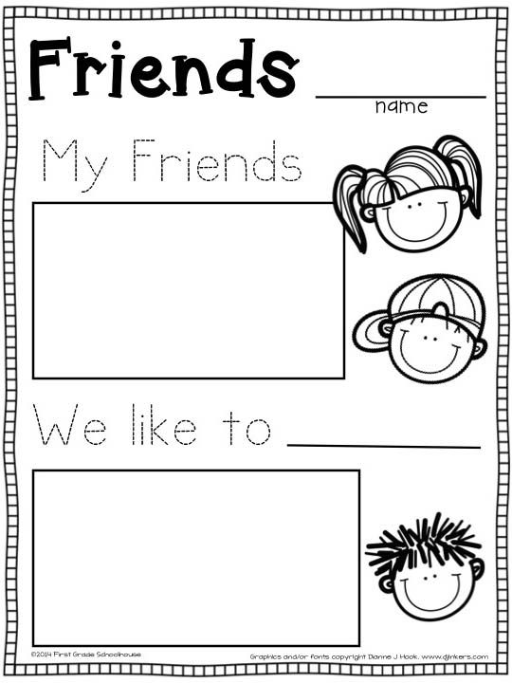
Task 1:Me and other people.

Slide 39
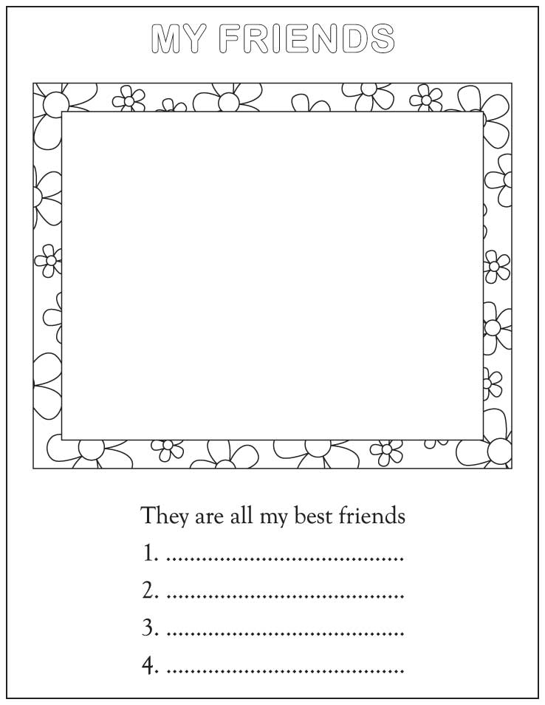
Task 2: Me and other people Draw a picture of yourself and other people.

Slide 40
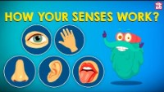
SENSES

Slide 41
LESSON OBJECTIVES
.Understand each of the five senses
.Compare the means by which the senses gather information about the world
. Explain how he/she cares for eyes, ears, nose, mouth and skin?

Slide 42
GROUP 1

Slide 43
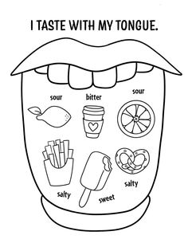
Task 2: Colour and match the five senses

Slide 44
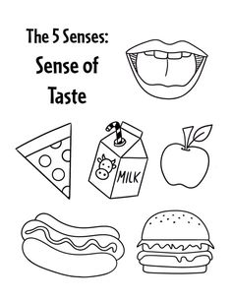

Task 2: Colour in the picture below

Slide 45
GROUP 2

Slide 46
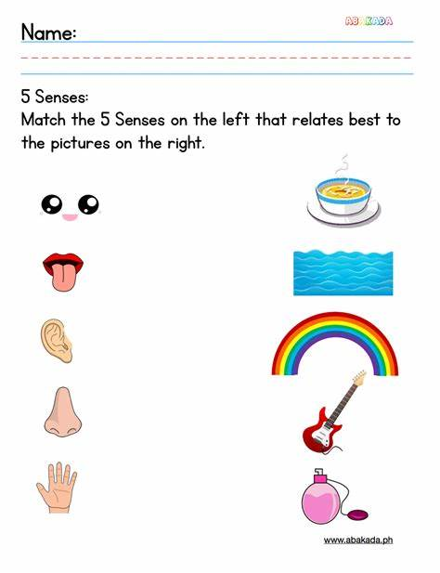

Slide 47
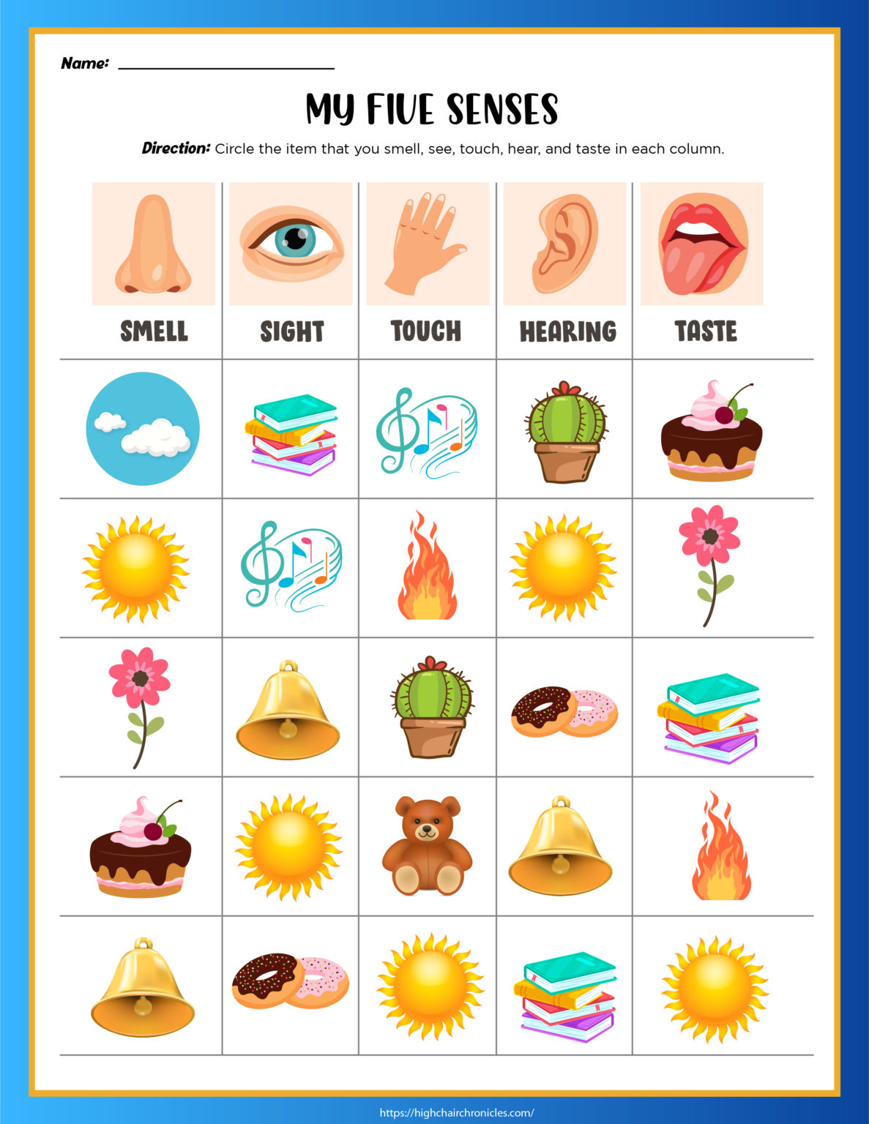
Task 2: Taste sense. Look at the picture below
and circle the correct sense.

Slide 48
GROUP 3

Slide 49
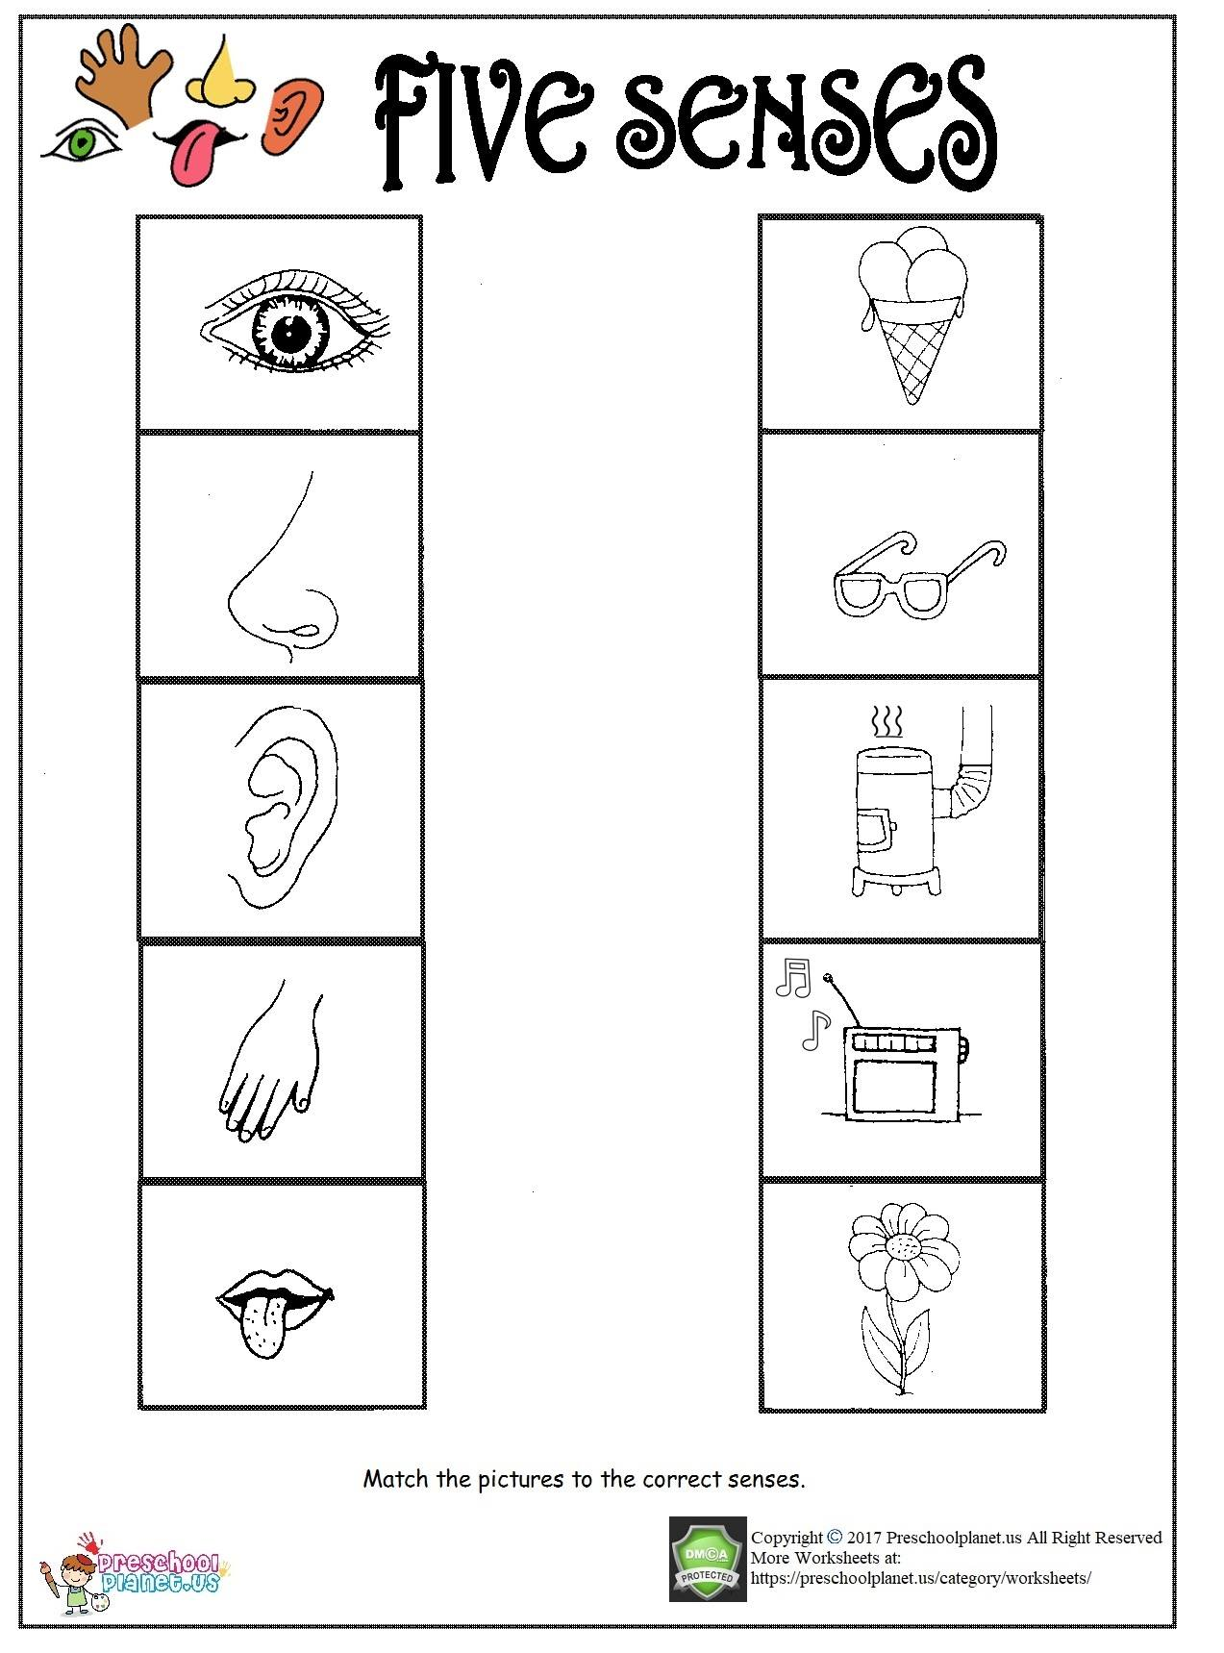
Task 1 Match and color.

Slide 50
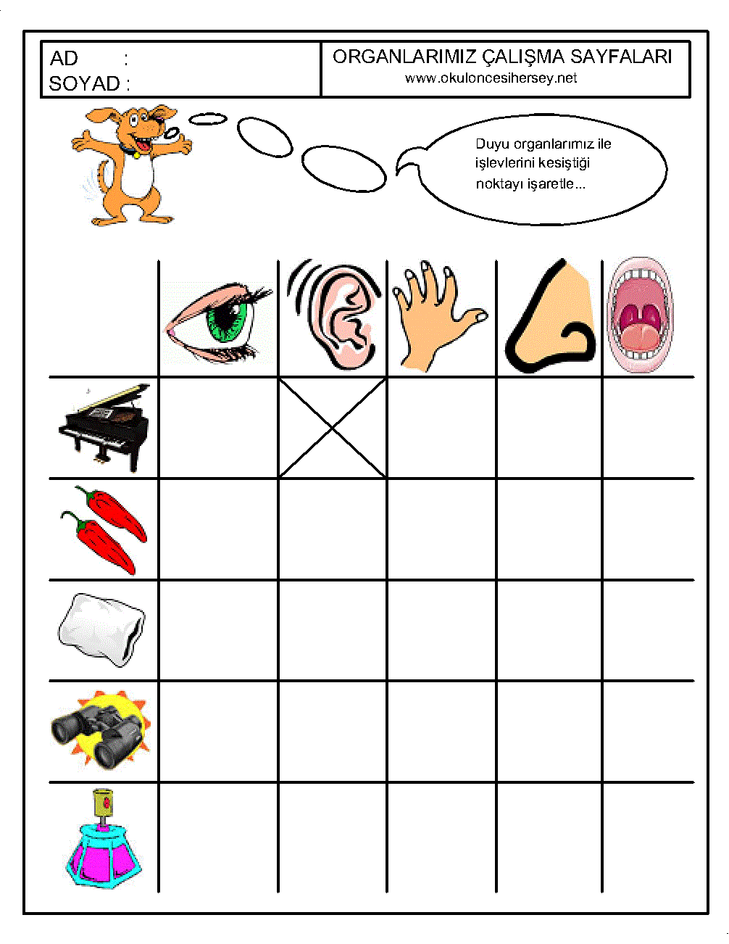
Task 2: .Complete the task below by placing an x to the correct block.

Slide 51
Resources
www.k5learning.com
www. sparklebox.co.uk
www.twinkl.co.za
www.Pinterest.com

